Slide 1
Event Emitters in Angular

Slide 2
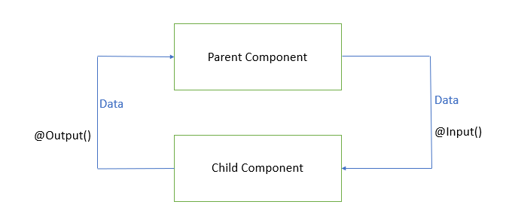
Event Emitters in Angular
An EventEmitter is used to emit custom events synchronously or asynchronously and register handlers for those events by subscribing to an instance.
Angular uses @Input and @Output decorators to flow data between components.
We can also use Angular services to flow data between the components.
If we have to pass data into a component, we use the @Input decorator, and if we have to emit the event or data from a component we use @Output decorator with the EventEmitter API.

Slide 3
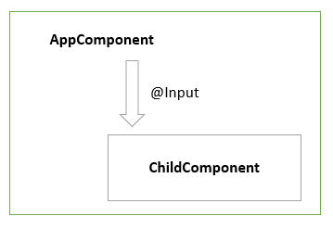
@Input decorator
In Angular, the @Input decorator is defined in the @angular/core package that marks a class field as an input property and supplies configuration metadata.

Slide 4
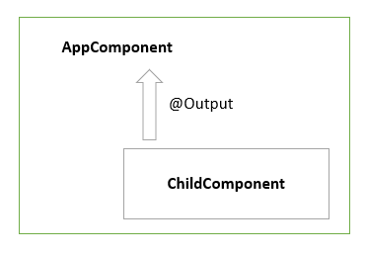
@Output
In Angular, a component can emit an event using @Output and EventEmitter API in the @angular/core package.
@Output decorator that marks a class field as an output property and supplies configuration metadata.

